Slide 1
Concepts of Boolean Algebra

Slide 2
Lecture 18 Standard Forms of Boolean Expressions
Lecture delivered by:
Deepak V.

Slide 3
Objectives
At the end of this lecture, student will be able to:
Acquire the knowledge of standard forms of Boolean expressions
Describe SOP
Acquire the knowledge of standard forms of General Expression
Converting Product Terms to Standard SOP

Slide 4
Topics
Standard Forms of Boolean Expressions
Implementation of an SOP
General Expression
The Standard SOP Form
Converting Product Terms to Standard SOP
Minterms

Slide 5
Standard Forms of Boolean Expressions
Boolean expressions can be manipulated into many forms
All Boolean expressions, regardless of their form, can be converted into either of two standard forms:
The sum-of-products form
The product-of sums form
Standardization makes the evaluation, simplification, and implementation of Boolean expressions much more systematic and easier

Slide 6
Implementation of an SOP
X=AB+BCD+AC
AND/OR implementation
NAND/NAND implementation
A
A
B
B
B
B
C
X
C
X
D
D
A
A
C
C

Slide 7
General Expression → SOP
Any logic expression can be changed into SOP form by applying Boolean algebra techniques
ex:

Slide 8
The Standard SOP Form
A standard SOP expression is one in which all the variables in the domain appear in each product term in the expression
Example:
Standard SOP expressions are important in:
Constructing truth tables
The Karnaugh map simplification method

Slide 9
Converting Product Terms to Standard SOP
Step 1: Multiply each nonstandard product term by a term made up of the sum of a missing variable and its complement. This results in two product terms.
As you know, you can multiply anything by 1 without changing its value
Step 2: Repeat step 1 until all resulting product term contains all variables in the domain in either complemented or uncomplemented form. In converting a product term to standard form, the number of product terms is doubled for each missing variable

Slide 10
Converting Product Terms to Standard SOP (example)
Convert the following Boolean expression into standard SOP form:
8

Slide 11
Binary Representation of a Standard Product Term
A standard product term is equal to 1 for only one combination of variable values
Example: is equal to 1 when A=1, B=0, C=1, and D=0 as shown below
And this term is 0 for all other combinations of values for the variables

Slide 12
Minterms
A minterm is a special product term, where each input variable appears exactly once
A function with n variables has up to 2^{n} minterms. For example, a three-variable function like f(x,y,z) has up to 8 minterms:
Each minterm is true for exactly one combination of inputs:
x’y’z’ x’y’z x’yz’ x’yz
xy’z’ xy’z xyz’ xyz
Minterm Is true when… Shorthand
x’y’z’ xyz = 000 m₀
x’y’z xyz = 001 m₁
x’yz’ xyz = 010 m₂
x’yz xyz = 011 m₃
xy’z’ xyz = 100 m₄
xy’z xyz = 101 m₅
xyz’ xyz = 110 m₆
xyz xyz = 110 m₇
Hey! This looks like a truth table!

Slide 13
Sum of minterms form
Every function can be written as a sum of minterms, which is a special kind of sum of products form.
The sum of minterms form for any function is unique.
If you have a truth table for a function, you can write a sum of minterms expression just by picking out the rows of the table where the function output is 1.
f = m₀ + m₁ + m₂ + m₃ + m₆
= Σm(0,1,2,3,6)
= x’y’z’ + x’y’z + x’yz’ + x’yz + xyz’
f’ = m₄ + m₅ + m₇
= Σm(4,5,7)
= xy’z’ + xy’z + xyz
f’ contains all the minterms not in f.

Slide 14
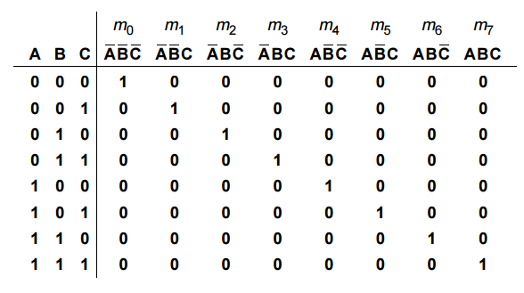
Sum of minterms form
The following table gives the minterms for a three-input system
Table: Minterms

Slide 15
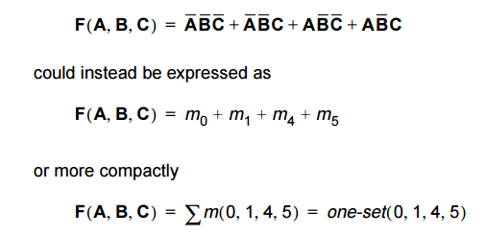
Sum of minterms form
Sum-of-minterms standard form expresses the Boolean or switching expression in the form of a sum of products using minterms
For instance, the following Boolean expression using minterms

Slide 16
Summary
All Boolean expressions, regardless of their form, can be converted into either of two standard forms
Any logic expression can be changed into SOP form by applying Boolean algebra techniques
A standard SOP expression is one in which all the variables in the domain appear in each product term in the expression
A standard product term is equal to 1 for only one combination of variable values
A minterm is a special product term, where each input variable appears exactly once.

